Slide 1
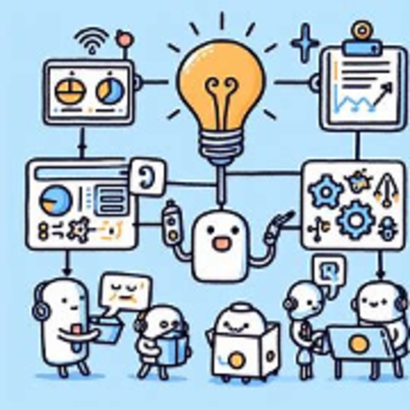
Getting Started with Machine Learning in R
Dr Giorgia Mori
Xinwei Luo
Sydney Informatics Hub

Slide 2
Code of Conduct
To foster a positive and professional learning environment, we encourage the following kinds of behaviours at all our events and platforms:
Use welcoming and inclusive language
Be respectful of different viewpoints and experiences
Gracefully accept constructive criticism
Focus on what is best for the community
Show courtesy and respect towards other community members
Our full CoC, with incident reporting guidelines, is available at https://pages.github.sydney.edu.au/informatics/sih_codeofconduct/
Notes:
In line with the University of Sydney Codes of Conduct for staff and students,

Slide 3


Learning by experience
Notes:
Machine Learning (ML) is the field of study that gives computers the ability to learn from data.
Imagine you decide to play the violin. The first time you pick up a violin, you probably will struggle to make sounds that are pleasing, let alone to play anything.
However, each successive time you practice your violin, you will get better and better. Eventually you will be able to produce good sounds, and with sufficient training you can play anything!
In machine learning, we use this same approach to train our models to solve problems.

Slide 4

Notes:
Part 1 and 2: Classical machine learning is often divided into two categories – Supervised and Unsupervised Learning.
In the first case, the machine has a "supervisor" or a "teacher" who gives the machine all the answers, like whether it's a cat in the picture or a dog. The teacher has already divided (labeled) the data into cats and dogs, and the machine is using these examples to learn. One by one. Dog by cat.
Today we are going to focus on regression.
Think of regression as predicting numbers (or divide the ties by length). You are asking to predict a numerical value given some input.

Slide 5
Notes:
The objective of the dataset is to diagnostically predict whether or not a patient has diabetes, based on certain diagnostic measurements included in the dataset.

Slide 6
Notes:
The objective of the dataset is to diagnostically predict whether or not a patient has diabetes, based on certain diagnostic measurements included in the dataset.

Slide 7
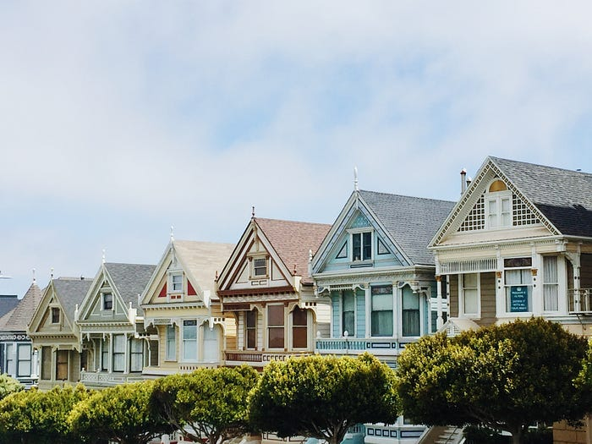
The Ames Housing dataset
Number of Instances: the dataset consists of 2,930 instances or observations.
Number of Features: there are 79 different features or variables that describe various aspects of the residential properties.
Target Variable: the target variable (or outcome) in the dataset is the ”sale_price" representing the selling price of the houses.
Data Types: the features include both numerical and categorical variables, covering a wide range of aspects such as lot size, number of rooms, location, construction, and more.
Notes:
The Ames Housing Dataset contains various features and attributes of residential homes in Ames, Iowa, USA.
[read]
Given the house features we want to predict the price.

Slide 8
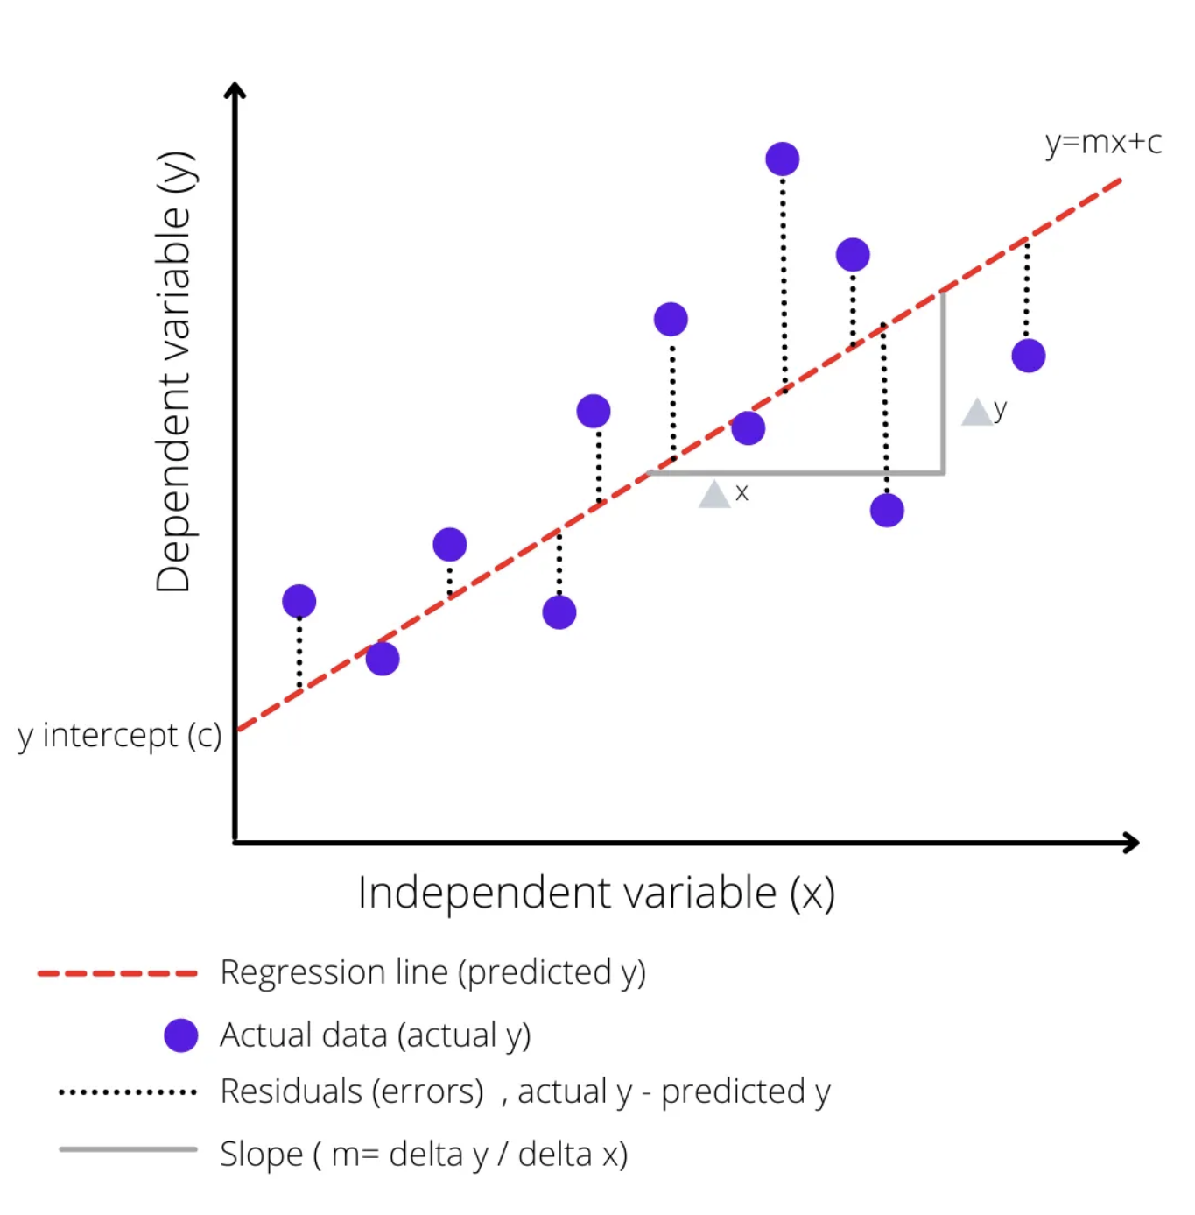
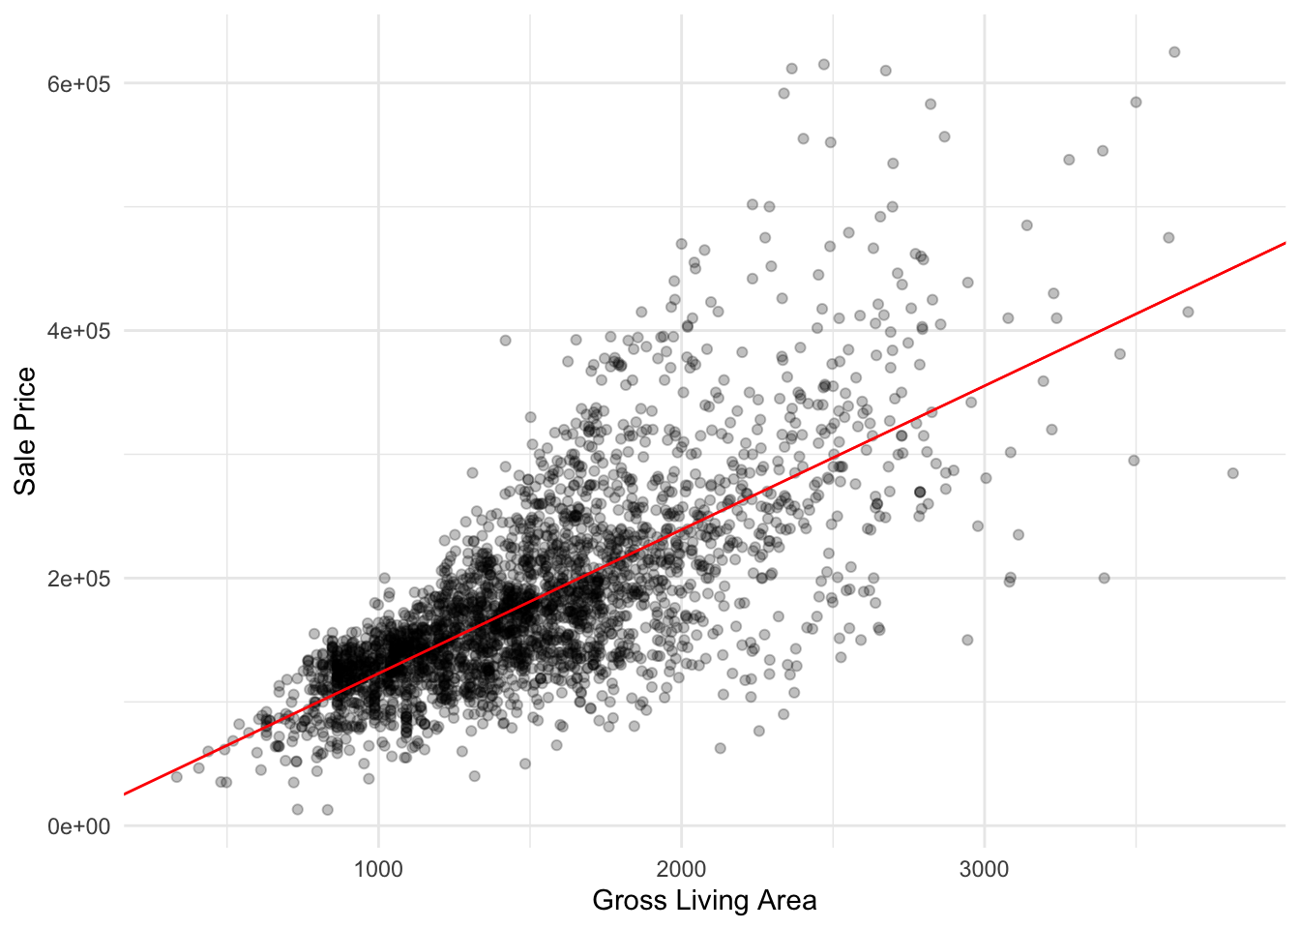
Linear regression
Notes:
Today you are going to build a linear regression model.
In a linear model, we assume that there is a linear relationship between the input variable(s) and the output variable. This means that as the input variable(s) increase or decrease, the output variable changes in a straight line.
Imagine you have a scatter plot with your data points all over it. A linear model is like drawing a straight line through the scatter plot that best fits all the points. The slope and intercept of this line are chosen in such a way that the distance between the line and all the points is minimized. This line is then used to predict the output for new input values.
You are going to do this with tidymodels.

Slide 9
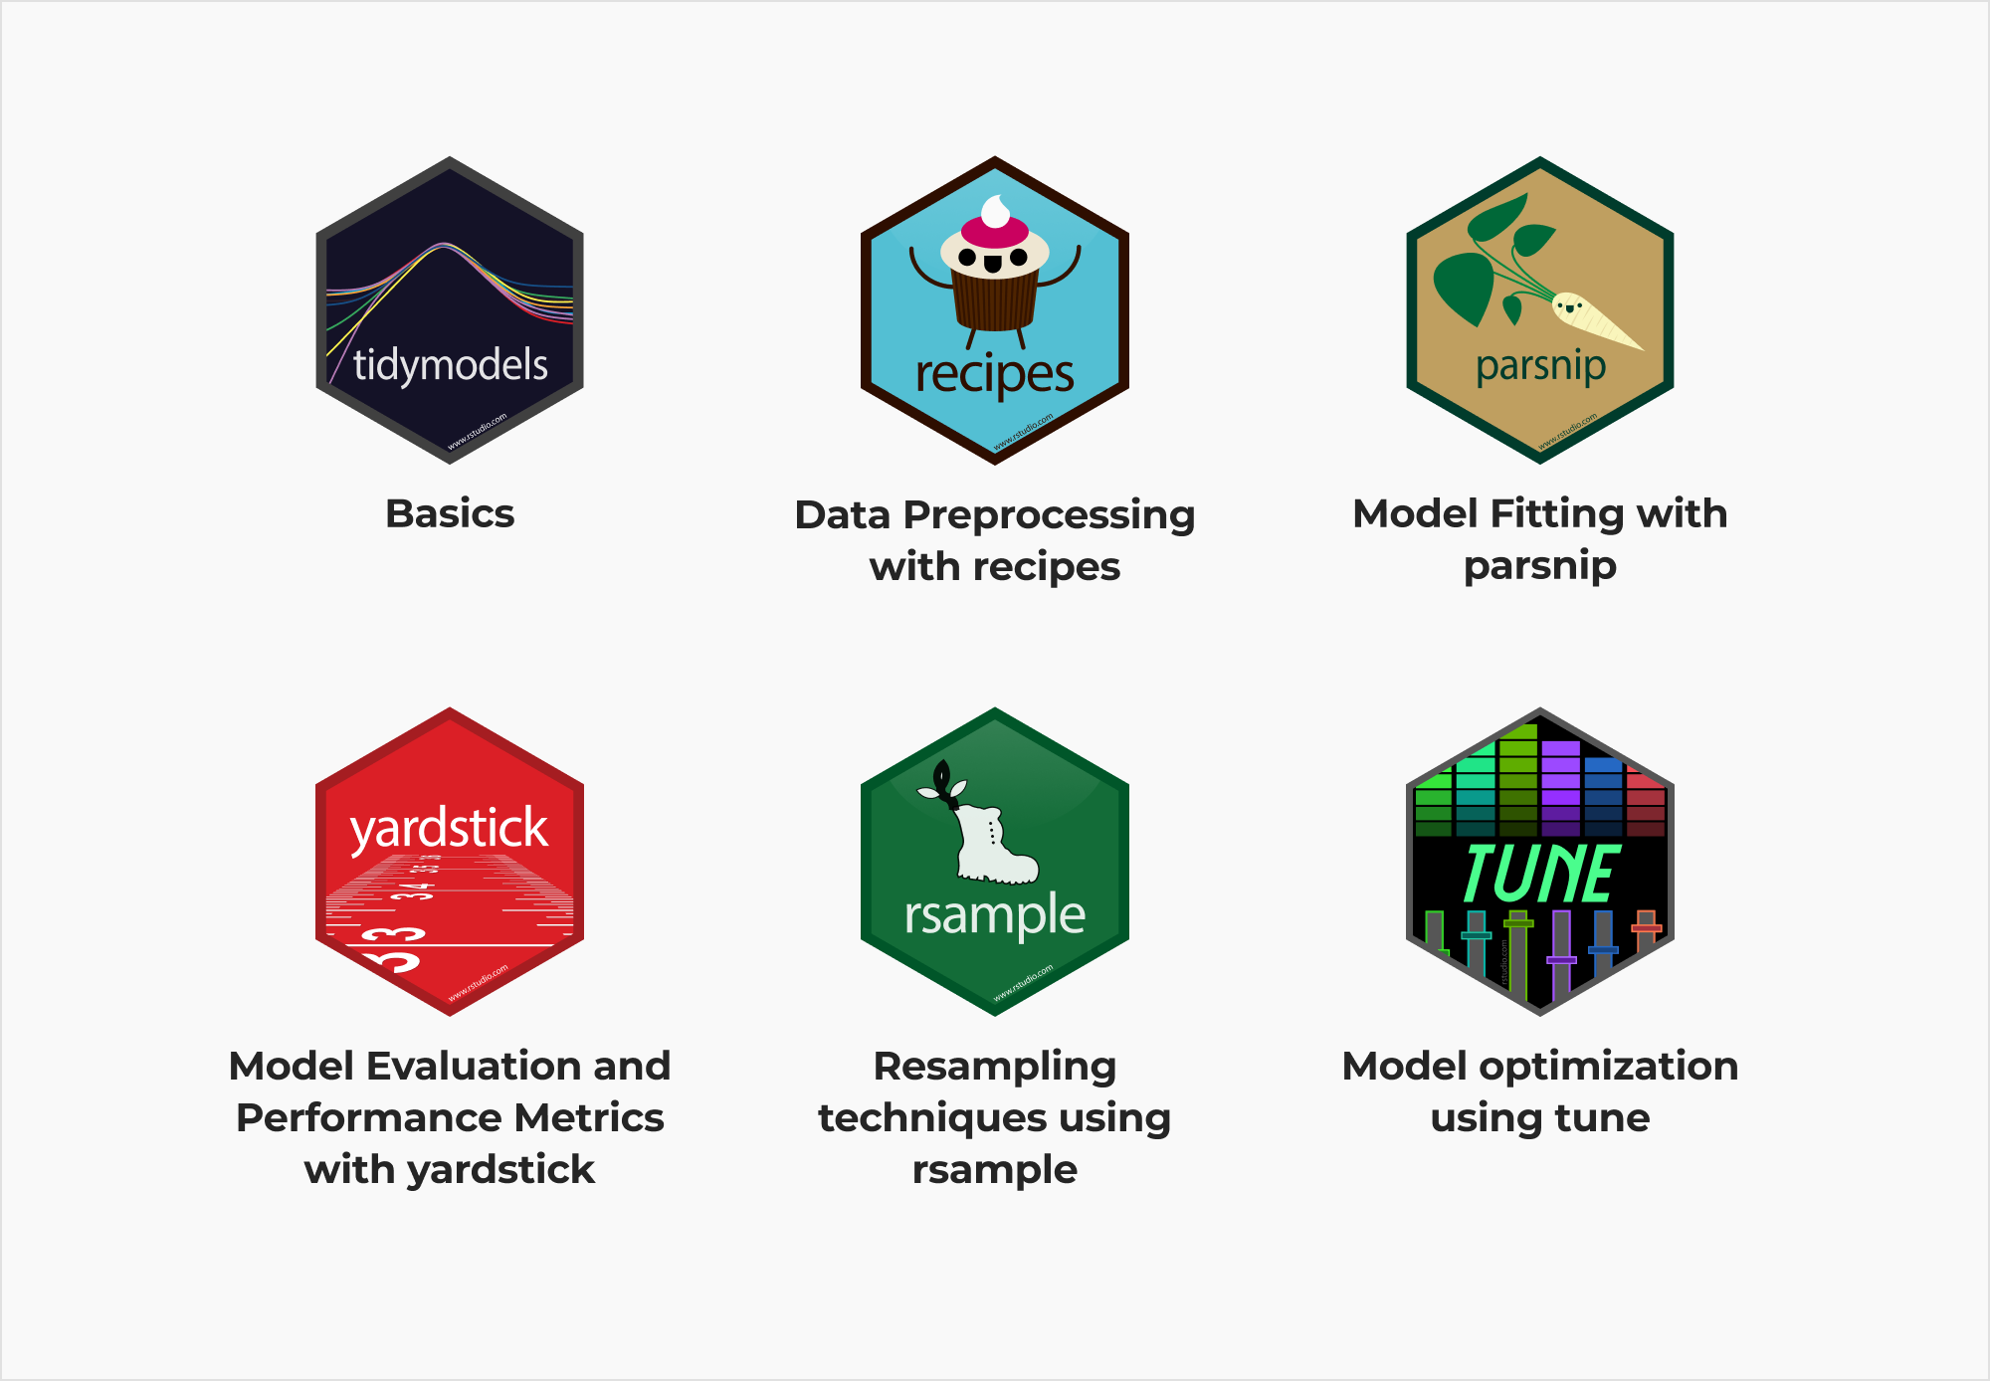
Tidymodels
Notes:
Tidymodels is a collection of R packages that provides a modern and consistent approach to building and validating machine learning models.
it uses a consistent and intuitive syntax across all of its packages, which makes it easy to learn and use
it is built on top of the tidyverse (dplyr, ggplot2)
it is actively developed and it has a growing community of users and contributors. This means that there are many resources available for learning and troubleshooting, and that the packages are likely to continue to evolve and improve over time.

Slide 10
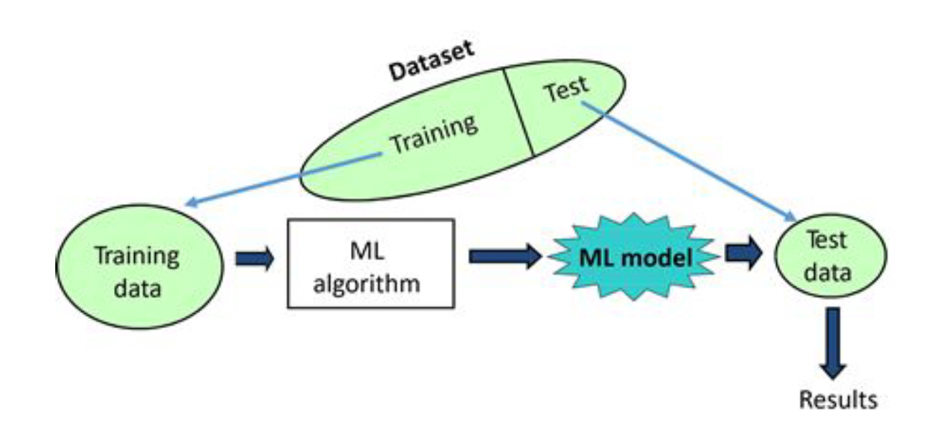
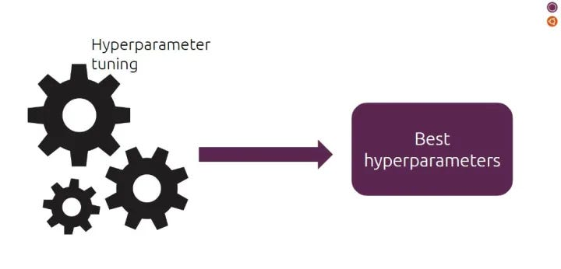
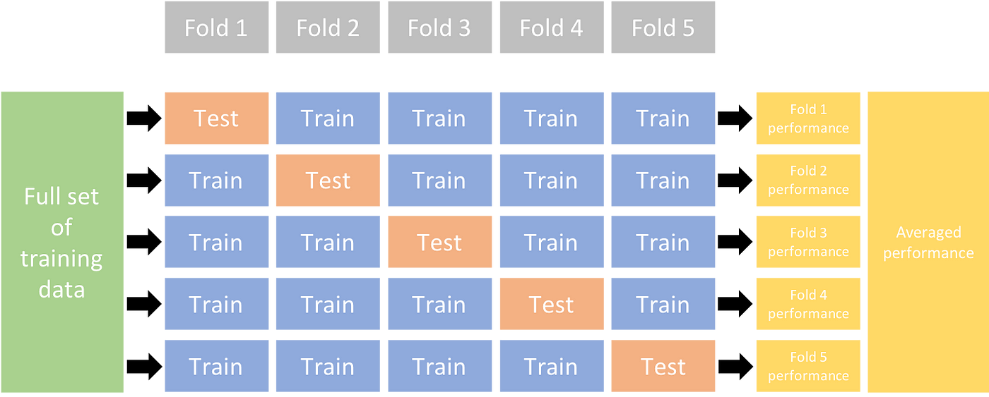
The whole game
Exploratory Data Analysis (EDA)
Splitting into training and test set
Using a resampling scheme
Building/Fitting models
Assessing performance
Choosing a model
Fitting and assessing the final model
Notes:
Things you are going to practice in the tutorial

Slide 11
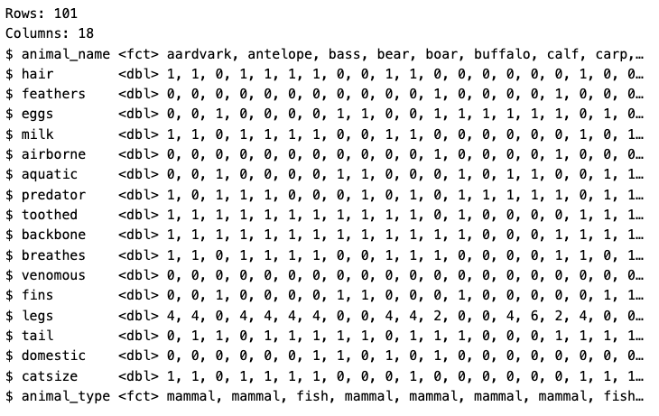
The zoo dataset

Slide 12
How to use the tutorial
Notes:
These tutorials consist of content along with interactive components for checking and reinforcing understanding. Throughout the tutorials you will find:
Narrative, figures and illustrations;
Code exercises that you can edit and execute directly;
Quiz questions...
Each tutorial automatically preserve work done within them, so if you work on a few exercises or questions and then return to the tutorial later, you can pick up right where you have left off. Start over.
Each tutorial includes a Table of Contents and it reveals content one sub-section at a time:

Slide 13
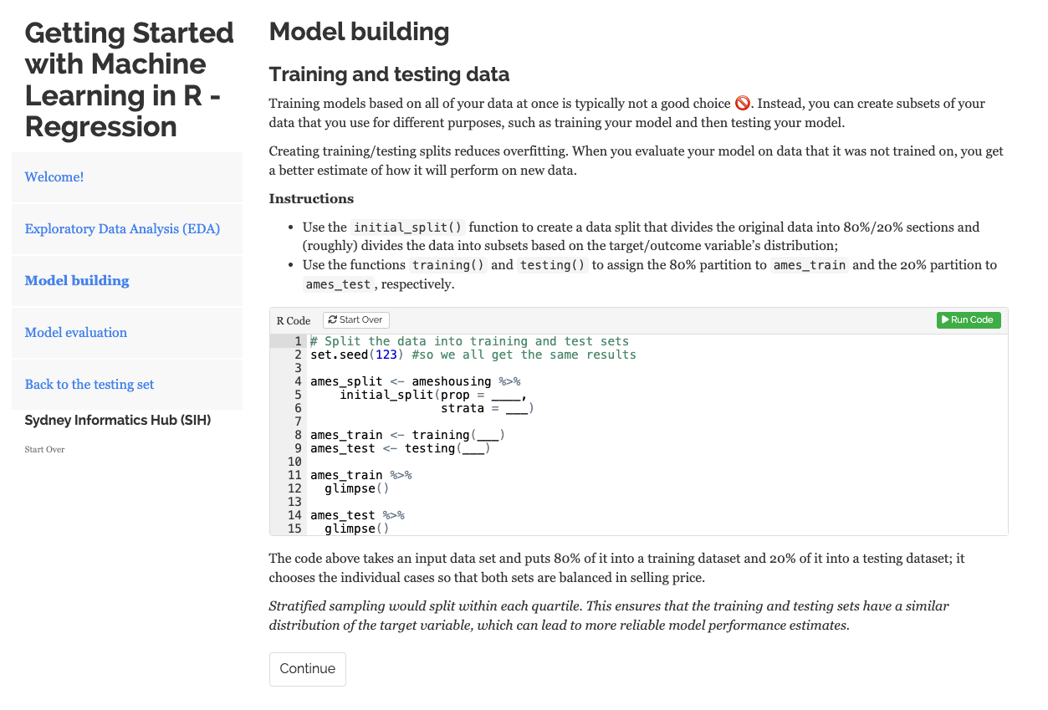
How to use the tutorial
Notes:
These tutorials consist of content along with interactive components for checking and reinforcing understanding. Throughout the tutorials you will find:
Narrative, figures and illustrations;
Code exercises that you can edit and execute directly;
Quiz questions...
Each tutorial automatically preserve work done within them, so if you work on a few exercises or questions and then return to the tutorial later, you can pick up right where you have left off. Start over.
Each tutorial includes a Table of Contents and it reveals content one sub-section at a time:

Slide 14
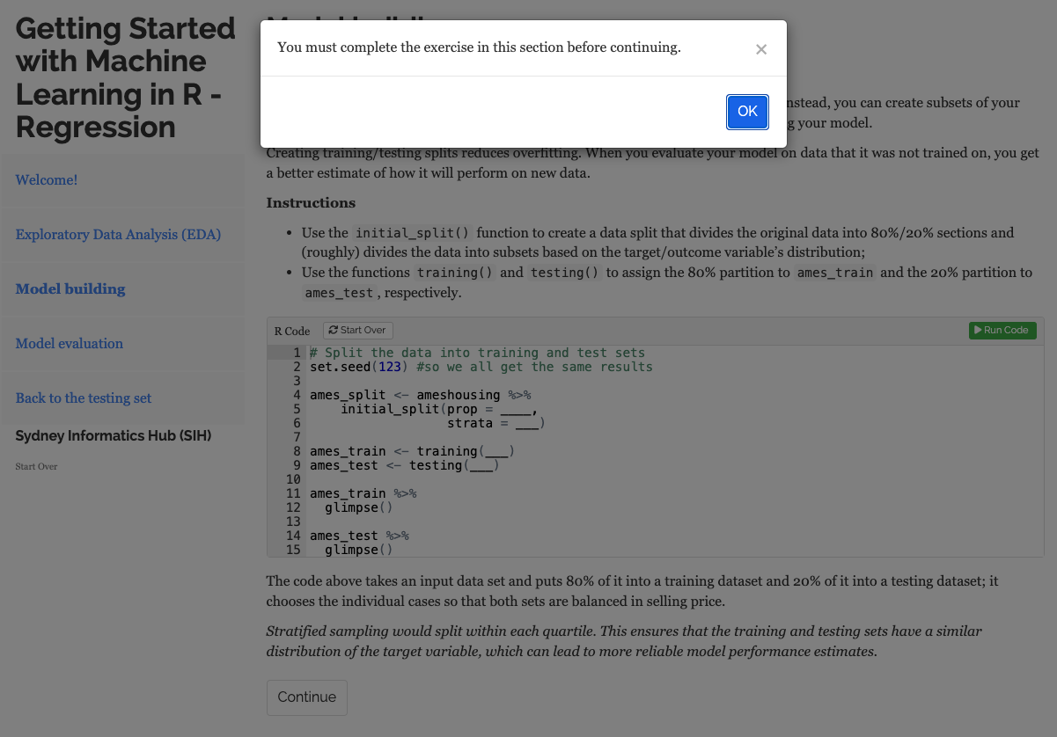
How to use the tutorial

Slide 15

Asking for Help
I have technical issues with my laptop
I need help understanding something
(which likely means others do too)
Notes:
Self-paced

Slide 16
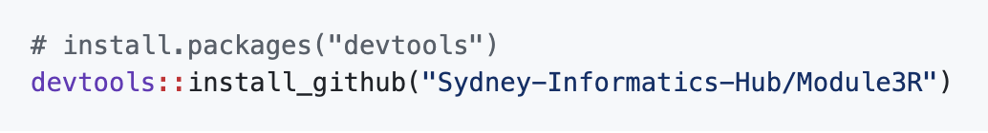

Your turn!
learnr::run_tutorial(”Part-3”, package = “Module3R”)
Your feedback is important!
Notes:
Re-run installation of the Module3R package before loading the tutorial

Slide 17

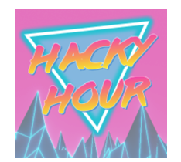


Your feedback is important!
Hacky Hour
15th May 2024 - 2pm
sih.training@sydney.edu.au
https://www.youtube.com/@sydneyinformaticshub1170
Notes:
Part 1: https://redcap.sydney.edu.au/surveys/?s=FJ33MYNCRR&training=75&training_date=2024-05-09
Part 2: https://redcap.sydney.edu.au/surveys/?s=FJ33MYNCRR&training=76&training_date=2024-05-16
Part 3: https://redcap.sydney.edu.au/surveys/?s=FJ33MYNCRR&training=77&training_date=2024-05-30

Slide 18

Your feedback is important!
Hacky Hour
19th June 2024 - 2pm
sih.training@sydney.edu.au
https://www.youtube.com/@sydneyinformaticshub1170
Notes:
Part 1: https://redcap.sydney.edu.au/surveys/?s=FJ33MYNCRR&training=75&training_date=2024-05-09
Part 2: https://redcap.sydney.edu.au/surveys/?s=FJ33MYNCRR&training=76&training_date=2024-05-16
Part 3: https://redcap.sydney.edu.au/surveys/?s=FJ33MYNCRR&training=77&training_date=2024-05-30

Slide 19
Your feedback is important!
Hacky Hour
19th June 2024 - 2pm
sih.training@sydney.edu.au
https://www.youtube.com/@sydneyinformaticshub1170
Notes:
Part 1: https://redcap.sydney.edu.au/surveys/?s=FJ33MYNCRR&training=75&training_date=2024-05-09
Part 2: https://redcap.sydney.edu.au/surveys/?s=FJ33MYNCRR&training=76&training_date=2024-05-16
Part 3: https://redcap.sydney.edu.au/surveys/?s=FJ33MYNCRR&training=77&training_date=2024-05-30

